Slide 1


Top 5
Popular
Categories

Slide 2


Today's agenda
Project recap
Problem
The Analytics team
Process
Insights
Summary

Slide 3

Client: Social Buzz - Social media & content creation platform
Founded in 2010, HQ in San Francisco
250 employees, 500M+ monthly active users
Objectives:
Audit big data practices
Provide IPO recommendations
Analyze top content categories
Approach:
3-month initial project to demonstrate value
Leverage internal expertise and past client stories
Data extraction, analysis, and stress testing
Collaborative workshops with client teams
Project Recap

Slide 4
Deliverables:
Big data best practices presentation
Sample data analysis and visualizations
Data center audit
IPO best practice documentation
Technology architecture review
Goals:
Prepare for successful IPO by end of next year
Implement big data management best practices
Identify opportunities in content strategy
Project Recap

Slide 5

Problem
500M+ monthly active users
100,000+ pieces of content posted daily!
Data is highly unstructured
Analysis to identify top 5 content categories by popularity

Slide 6


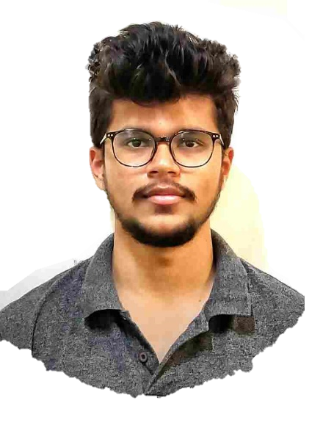
Andrew Fleming
Chief Technology Architect
The Analytics team
Marcus Rompton
Senior Principal
Sujan Tumbaraguddi
Data Analyst

Slide 7
Process
1
Selection of Data sets
2
Data Cleaning
3
Data Modelling
4
Data Visualization
5
Insights

Slide 8
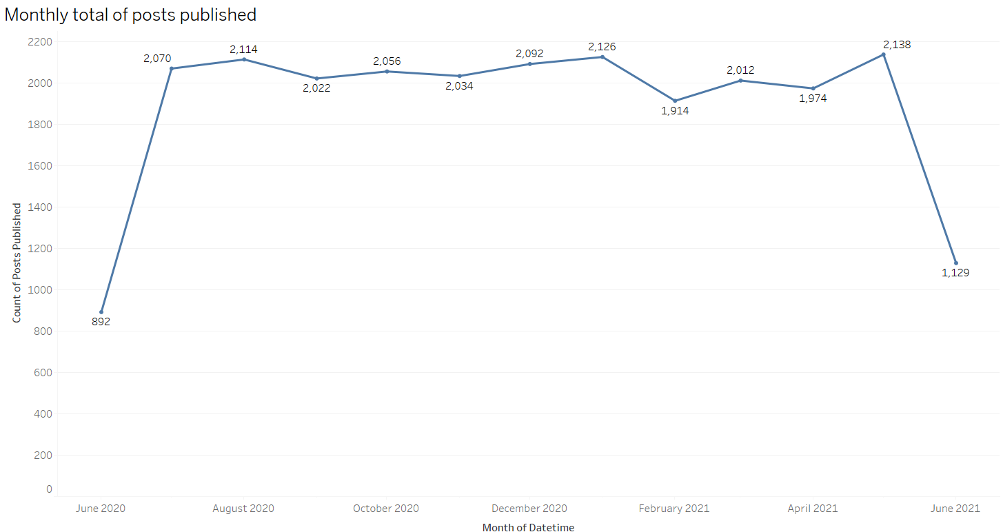

Insights

Slide 9
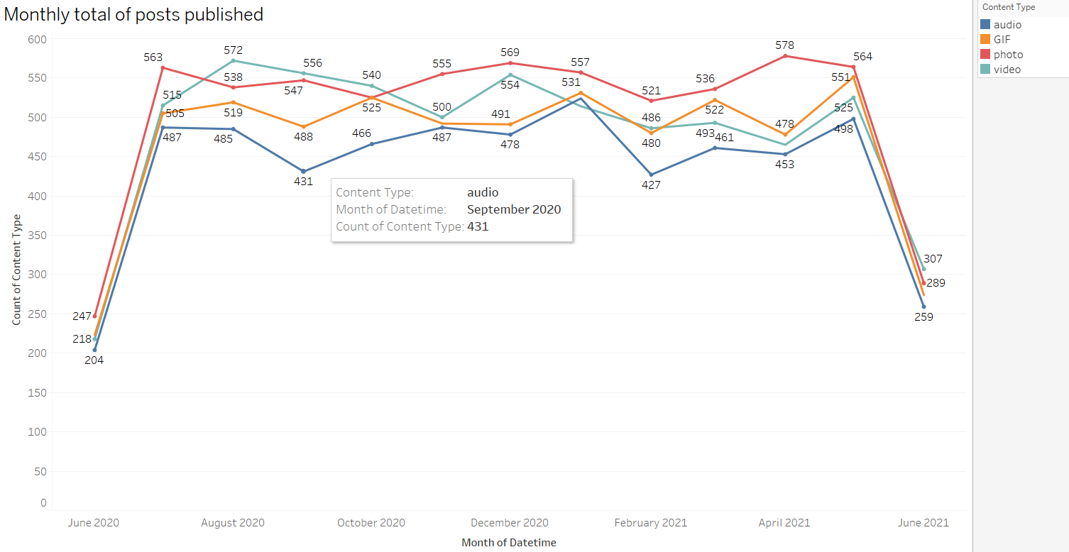

Slide 10
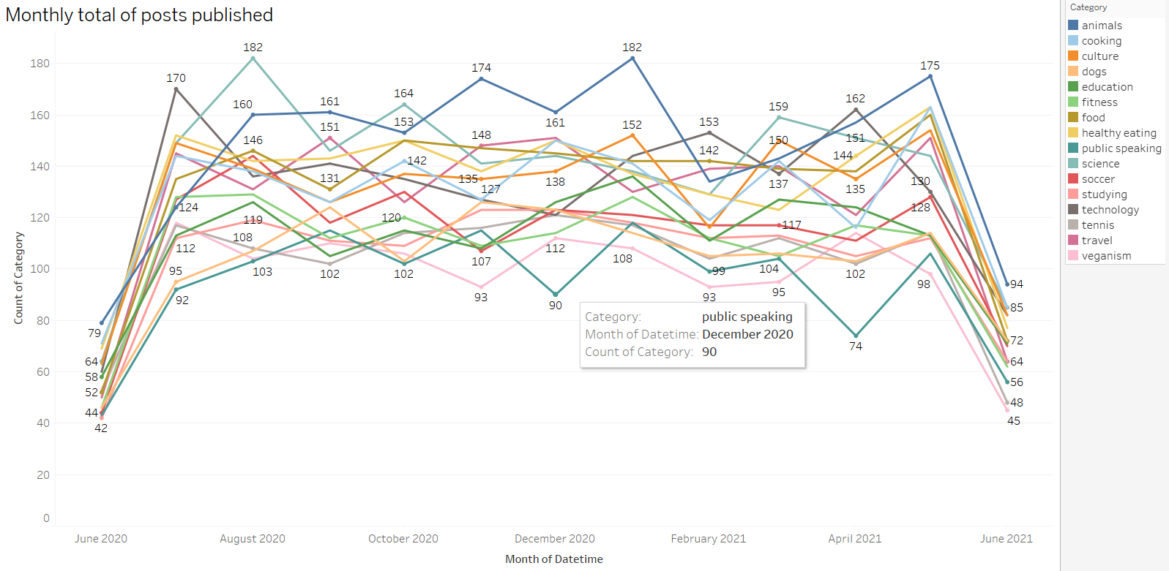

Slide 11
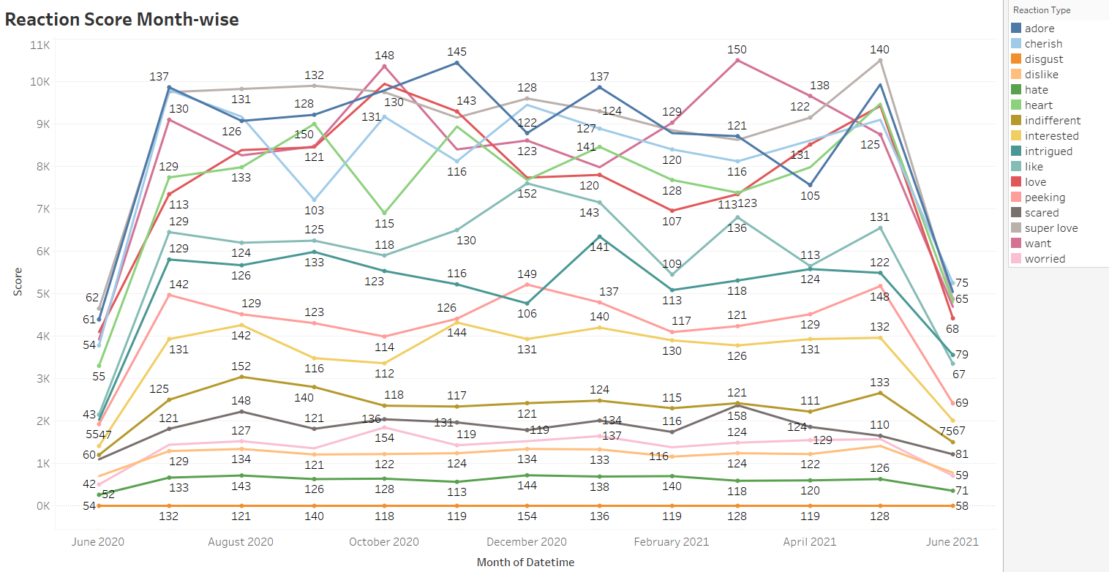

Slide 12
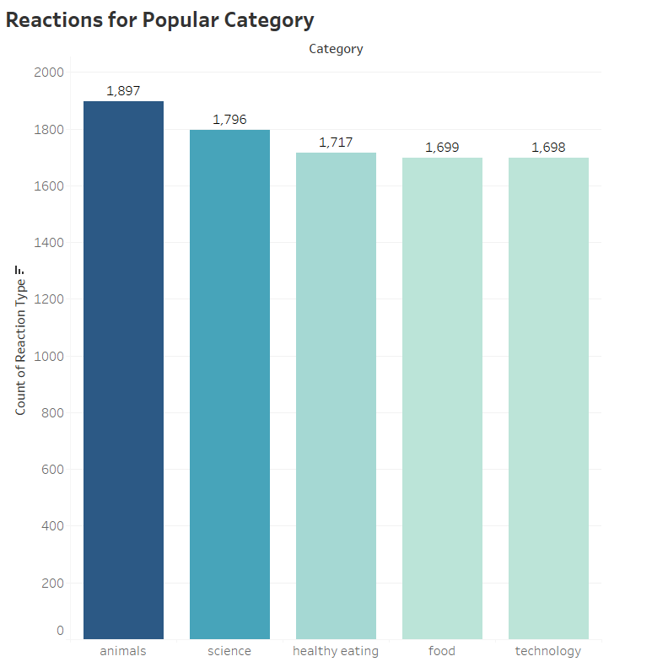

Slide 13
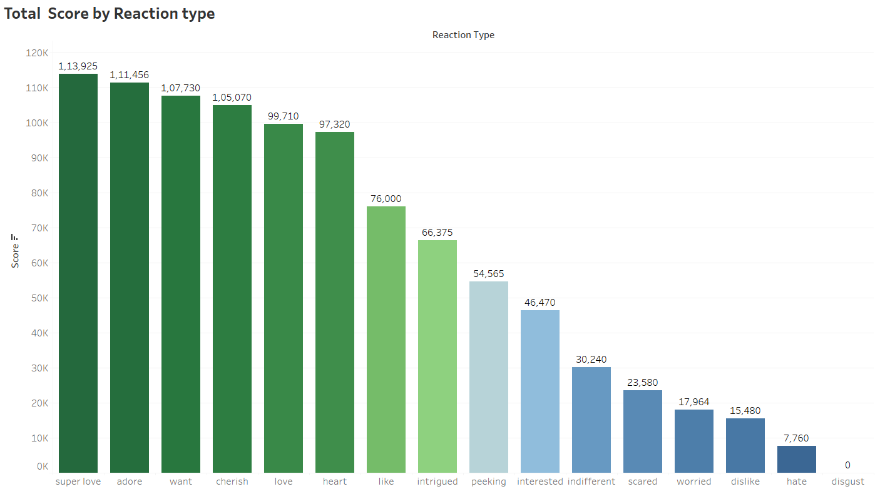

Slide 14
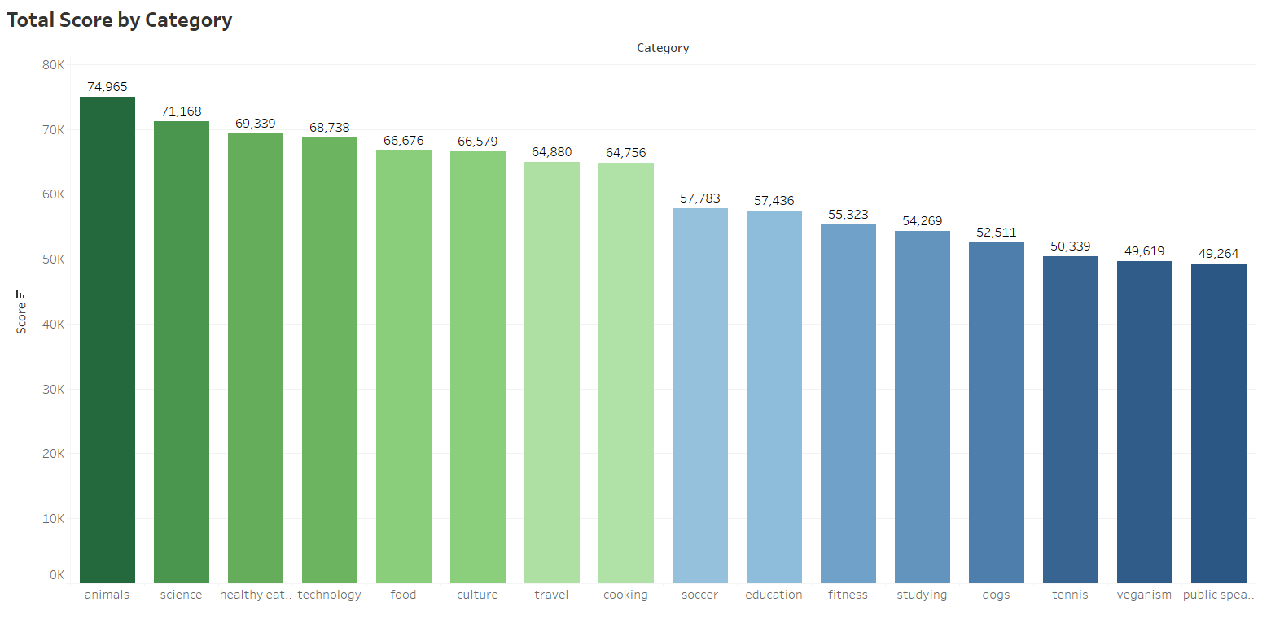

Slide 15
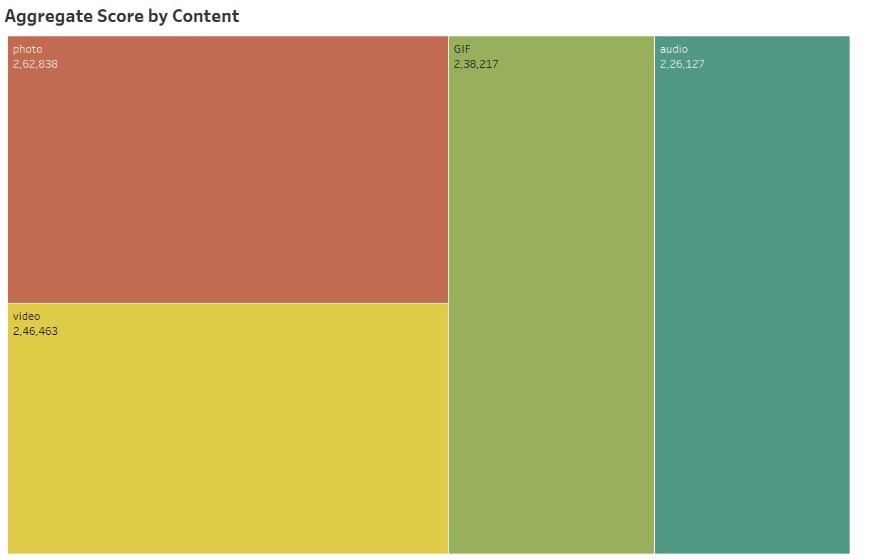

Slide 16
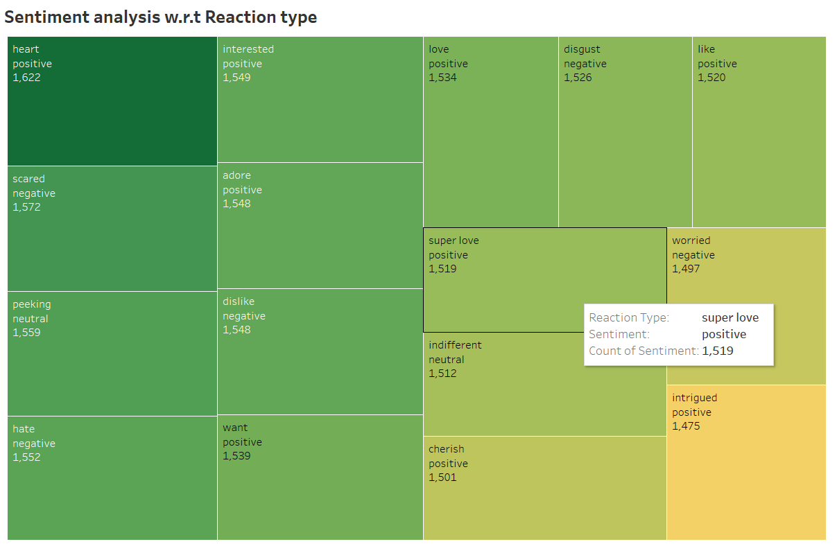

Slide 17

The two most popular content categories are science and animals, indicating that people are most drawn to "real-life" and "factual“information.
The top 5 categories all have food as a common theme, with "healthy Eating" coming in first. This could provide insight into your user base's audience. With this knowledge, you might develop a campaign and collaborate with companies that promote healthy eating to increase user engagement.
Although this analysis is enlightening, it's time to put it into large-scale production to gain a real-time understanding of your company. We can walk you through the process.
Summary

Slide 18
Thank you!
ANY QUESTIONS?

